Slide 1

BEATS, HOPS ‘N’ CODE
FizzBuzz CODE KATA

Slide 2
AGENDA
AGENDA
BEATS, HOPS ‘N’ CODE
1
2
3
4
FizzBuzz
Mechanics
Showtime
Contact

Slide 3
CYMBAL
PRODUCT OVERVIEW
FIZZBUZZ
CODE KATA
BEATS, HOPS ‘N’ CODE

Slide 4
CODE KATA
BEATS, HOPS ‘N’ CODE
Example run
RULES
1
2
Fizz
4
Buzz
Fizz
7
8
Fizz
Buzz
11
Fizz
13
14
FizzBuzz
Method that receives numbers
If is multiple of 3, return Fizz
If is multiple of 5, return Buzz
If is multiple of 3 and 5, return FizzBuzz
Else, return the number

Slide 5
CYMBAL
PRODUCT OVERVIEW
MECHANICS
CODE KATA
BEATS, HOPS ‘N’ CODE

Slide 6
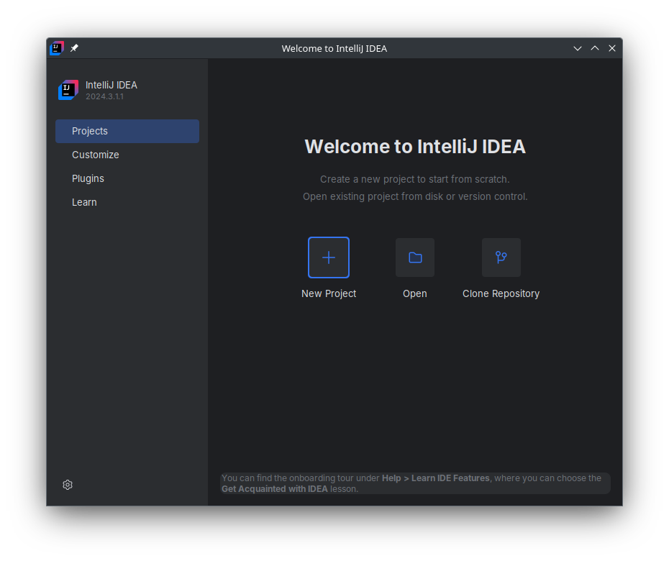
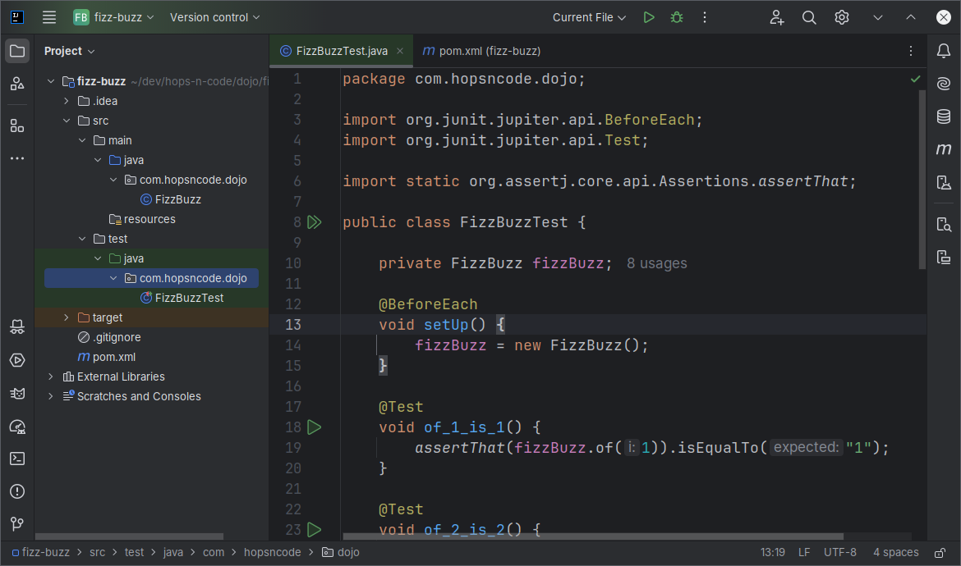
MECHANICS
PROBLEM & SOLUTION
WHO WE ARE
Work on your own IDE
Follow along
Pauses for quick questions
Pay close attention!

Slide 7
CYMBAL
PRODUCT OVERVIEW
SHOWTIME
CODE KATA
BEATS, HOPS ‘N’ CODE

Slide 8
CODE KATA
BEATS, HOPS ‘N’ CODE
BEATS, HOPS ‘N’ CODE
César Romero
hops.n.code@gmail.com
https://github.com/hops-n-code

